Slide 1
Global Review

Slide 2
Exam Format
Paragraph responses
Cartoon analysis
Essay

Slide 3
Stages of Genocide
Causes of tension in the Cold War
Blame in the Cuban Missile Crisis
Colonization of Africa

Slide 4
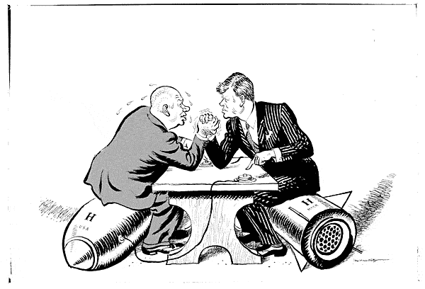
Explain event Describe cartoon, people, places, Symbols, objects Cartoonist’s point of view Provide a title

Slide 5
Khruschchev and Kennedy Cuban Misile Crisis Bombs, Buttons, sweat and arm wrestling are all things to be interpreted

