Slide 1
Urbanization

Slide 2
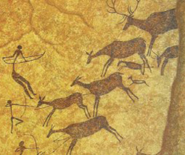
Migrant Communities
Earliest human groups had a Nomadic lifestyle.
Why did they live in groups?
- Protection
- Easier to hunt
- Gather food
Notes:
2
Development of agriculture:
Created a stable location
Meant a more regular food supply
Meant Less time need for gathering
Gave rise to the first villages
Allowed villagers to put more time into other activities.

Slide 3
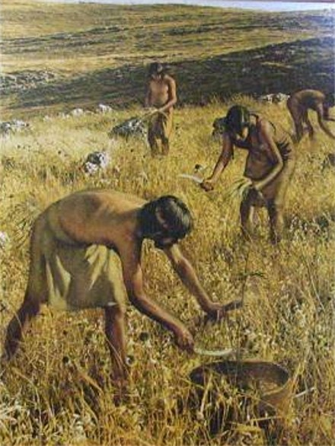
First Villages
How did the development of agriculture affect the people?
- stable location
- regular food supply
- less time for gathering
- gave rise to the first villages
- more time for other activities, producing other goods, scientific activity.
Notes:
3

Slide 4
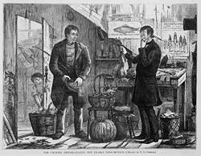
Trading Communities
Intra & inter-village trade created potential for a new profession.
Buying & selling goods
communities developed to help other communities trade.
Notes:
4

Slide 5
Impact of the Industrial Revolution
Notes:
5
Ex. mining, forestry, farming, grazing, hunting, gathering, fishing, & quarrying

Slide 6
Impact of the Industrial Revolution
Improved food production led to less need for farm workers.
People left the rural areas for factory jobs in the city.
Notes:
6
Ex. metal working, smelting, textile production, and engineering

Slide 7
Industrial Revolution
Formation of middle class professions. Ex. Bankers, lawyers, managers.
People had more income.
People could enjoy more goods.

Slide 8
This is the driving force behind Urbanization.
Great cities such as London and Paris emerged as factory towns.
People increasingly left the farms to live in the cities.

Slide 9
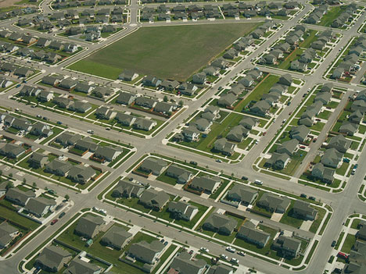
What is Urban Sprawl
Urban Sprawl is a pattern of land use that is characterized by spread out automobile dependant development outside of more compact city centers.

Slide 10
Characteristics
Excessive land consumption
Low population densities
Lack of transportation options

Slide 11
Benefits
Land prices decrease as you move away from the city center
Middle class people opt for cheaper homes and a perceived higher standard of living outside of the city
The car makes it all possible

Slide 12
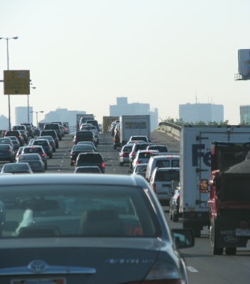
Problems with Urban Sprawl
Inefficient land use
Increased energy consumption
Increase in tax burden.
Expensive to service.
Takes population away from
downtown areas.

Slide 13
Problems continued
Leads to isolation and fragmentation of communities.
Can cause depressed areas in the city core areas.
Less chances for small businesses.

Slide 14
Final Assignment
Answer the following questions in one half page answer.
How did the industrial revolution lead to urban growth?
How does urban sprawl negatively affect the social, economic and environmental condition of a given area.

