Slide 1
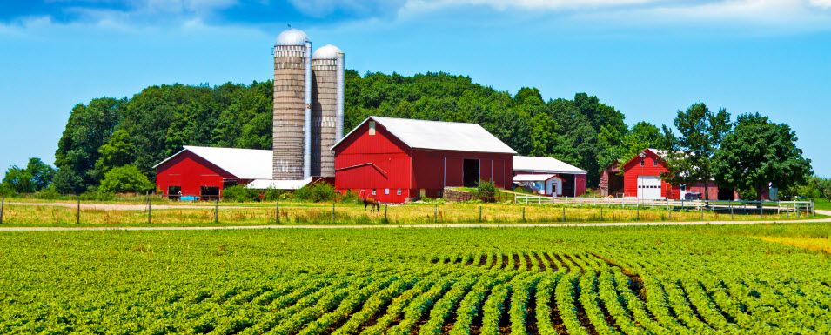
Feeding the World

Slide 2
4 types of Farming
Subsistence: Farming that involves only rearing enough animals and/or growing enough crops to support immediate friends and family.
Cash Crop: A cash crop is an agricultural crop which is grown for sale to return a profit.
Intensive: Intensive farming or intensive agriculture is a kind of agriculture where a lot of capital and labour are used to increase the yield that can be obtained per area.
Extensive: Extensive farming or extensive agriculture (as opposed to intensive farming) is an agricultural production system that uses small inputs of labor, fertilizers, and capital, relative to the land area being farmed.

Slide 3
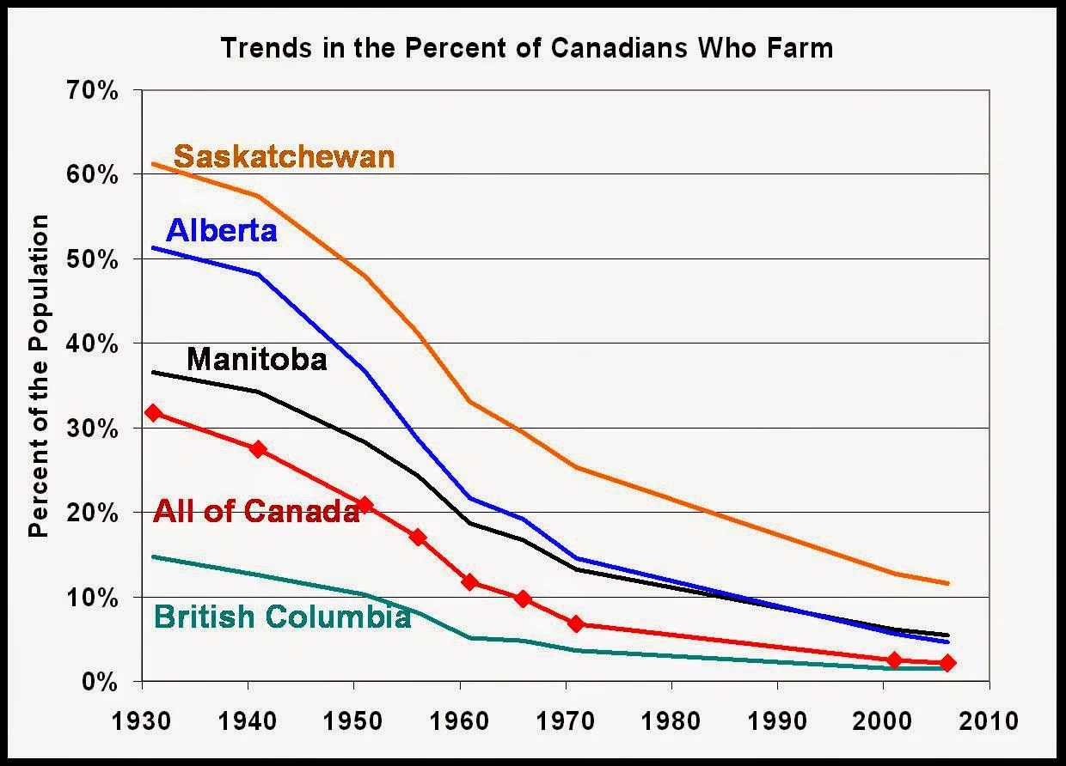
Farming Trends in Canada

Slide 4
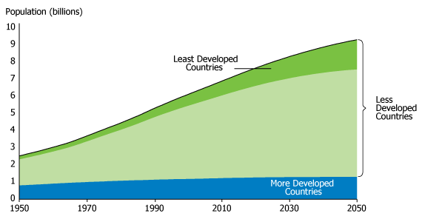
World Population Growth

Slide 5
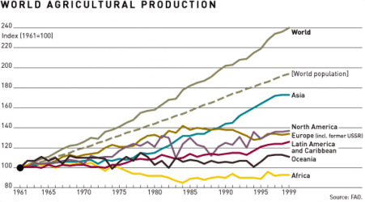
World Food Production and Population

Slide 7
Green Revolution start at 5 mins in
https://www.youtube.com/watch?v=Lg9-HTtgFOk
https://www.youtube.com/watch?v=gIdMMwTTklc

Slide 8
Article Questions
Define the 4 types of farming.
What are High-Yields varieties? Why are HYV crops not environmentally sustainable?
How did the Green Revolution favour the wealthier farmers? How did it benefit developed countries and corporations?
Why did the Green Revolution fail to solve the food crisis in African Countries?
In a half page evaluate the effectiveness of the Green Revolution as a solution to world hunger.

