Slide 1
Enhancing Teacher Collaboration and Technology Infused Lessons

Slide 2
Seminar Plan
History of Technology in Education
Present Technology Use
How Are We Doing?
The Way Forward: Technology as a Tool For Learning
Teacher Collaboration Using Google Apps for Education
Tool Focused Technology Examples
Summary

Slide 3
Technology Use Throughout History

Slide 4
Activity: What technologies have we used in the past? What technologies do we use now?
Past
Present
Notes:
This is a representation of a handout

Slide 5
21st Century Technology

Slide 6
Group Discussion Questions
Has our use of technology increased?
Has our use of technology changed?
What are the obstacles to adopting new technology?

Slide 7
Technology Use in the Past
Program Learning (learning the Microsoft Office Suite) Mostly in a specific tech course.
Not cross curricular (Math, Science, Computer classes)
Left out of English and Social Studies classes
Lessons focused on exposure to technology, not integrated into lessons.

Slide 8
Present Day Technology Use
Technology is used cross curricular.
English and Social Studies classes now embrace it more.
PowerPoint lectures, Internet video, part of day to day classrooms.
Smartboard technology mostly used in Science and Math classes.
Most teachers have websites

Slide 9
Present Day Technology Obstacles
Time for training and learning.
Little support given for new mandatory programs such as PowerSchool, Gradebook and Tienet.
Integrated but is it as effective as it could be?
Does it still seem like extra work or is it making work easier?
Are we using it to collaborate?

Slide 10
Present Technology Use: Students
Students are using more technology but is it guided?
Are we modeling how to use it effectively? For example, how to we use it for research? Are we encouraging students to do this as well.
Are they an audience to the great new lesson or are they using the technology to promote learning.
Are we truly teaching them how to use it as a tool for learning?

Slide 11
2015 OECD Report Findings
New approach needed to deliver on technology’s potential in schools
15/09/2015 - “Schools have yet to take advantage of the potential of technology in the classroom to tackle the digital divide and give every student the skills they need in today’s connected world, according to the first OECD PISA assessment of digital skills.”
“In 2012, 96% of 15-year-old students in OECD countries reported having a computer at home, but only 72% reported using one at school. Overall, students who use computers moderately at school tend to have somewhat better learning outcomes than students who use computers rarely. But students who use computers very frequently at school do much worse, even after accounting for social background and student demographics.”
Notes:
OECD. “New approach needed to deliver on technology’s potential in Schools” Retrieved from http://www.oecd.org/education/new-approach-needed-to-deliver-on-technologys-potential-in-schools.htm

Slide 12
OECD Findings
The stats say there is definitely a benefit to having computers in the classroom as long as they are used effectively.
Too much exposure can be bad especially if it is not guided.
Types of technologies are now changing and we must integrate these into our lessons.

Slide 13
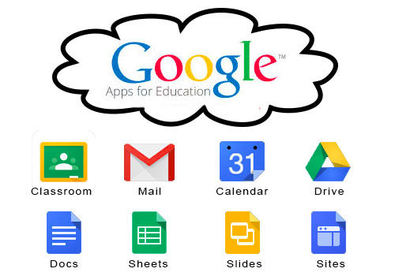
Using Technology as a Tool for Teacher Collaboration

Slide 14
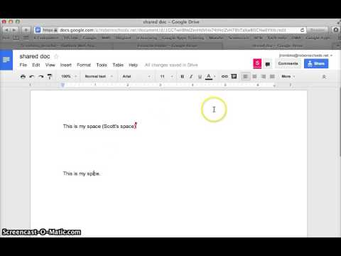
Using Technology as a Tool for Teacher Collaboration

Slide 15
Teacher Collaboration
This technology can make it very easy for teachers to collaborate from all over the city, province etc.
PLCs that were not possible because of teachers schedules could now be done online.
Teachers can easily share resources with one another.
This is better than a website because you can control who sees it and who can edit it.
All in real time.
This is a way technology can make our lives easier.

Slide 16
PLC Collaboration example
Two other teachers and myself were teaching Global Geography 12.
One had a student teacher.
We were able to share materials very easy with Google Drive.
We each added used and modified documents to fit our needs.
Easily accessible did not have to email or wait
Could easily see each other’s progress in the course
This made things easier.

Slide 17
Technology Infused Lessons

Slide 18
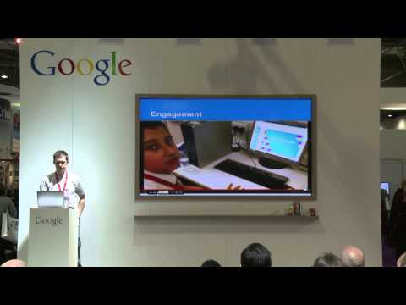
Student Collaboration Example

Slide 19
Peer Collaboration
This a great example of how to use technology as a tool for learning.
It is taking something we already value and making it easier to integrate.
Inclusive of all students especially those who do not like to speak in front of the class.
Way to check the participation and understanding of all students.
Is different than how you usually use technology?
Can you see how this is an example of technology as a tool to aid learning?

Slide 20
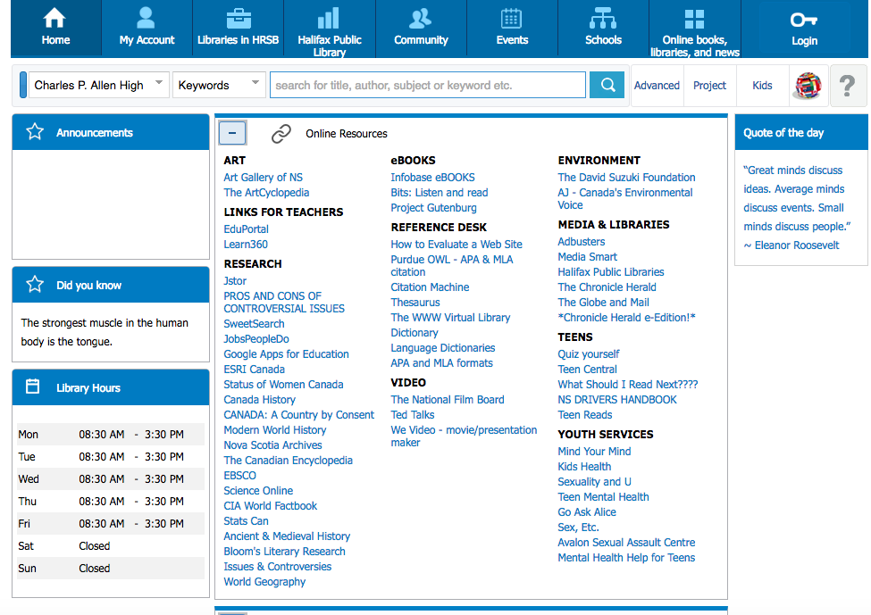
Teaching Research - Our Library

Slide 21
Student Research
Our Library has access to a wealth of online resources.
The internet has made research easier but not better. Students need to be educated on using academic sources
Schools have paid for memberships to many ejournals and it is in my experience students are still just “Googling it”
Online journals need to be encouraged as this is how research is done at higher levels.
It is also very easy once students are shown the wealth of academic information they have access to.

Slide 22
The Flipped Classroom
The Flipped Classroom is a new way to support students and promote more engagement in their learning.
The purpose of the flipped classroom is to give students a way to learn content on their own time.
This enables students to have the background necessary to engage in higher learning in the classroom.
The flipped classroom can replace in class lectures and content delivery enabling more time for activity based learning and applying the concepts learned.
Student will be able to contribute more effectively and comfortably in the classroom setting as they will already had exposure to the content.

Slide 23
Application for the Social Studies Classroom
Social studies course have used the idea of the flipped classroom as part of normal teaching strategies.
Students have always been expected to do readings outside of class and be ready to discuss.
However, the new flipped classroom technology can offer a great deal to students.
Instead of providing students with one form of media, usually a reading, we can now offer many formats which will promote student learning and engagement.
This will provide students with the ability to learn at their own pace and bring questions to class. Multimedia formats such as recorded lectures, documentaries, interactive maps can all be used to promote student learning and engagement.

Slide 24
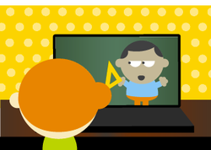
Resources for the Flipped Classroom
Sophia.org - a website which offers a course in creating flipped classrooms. On their splash page are many introductory tips on flipped classrooms as well as a tutorial which walks through how to organize materials for flipped lessons.

Slide 25
Flipped Classroom Resources
Khan Academy - Khan Academy has been specialising in online lessons for quite a while however their focus has been on more skills based courses such as math and computer programming. They have now began to delve into History and provide a some great introductory materials.
They also provide some assessment materials which could be used to allow students to self evaluate and come to class prepared with questions. They have now added functionality to create a course online and have students join.

Slide 26
History and Geography Example lessons
On my Website you can find some other examples of lessons.
http://globalpowers.weebly.com/welcome-page-for-educ-5203.html

Slide 27
Summary
Technology needs to be integrated and seen as a tool to make us more efficient.
It should make our jobs easier not more difficult.
It should help us find more effective ways to do what we already know works, such as research, peer collaboration.
It should make our lessons more effective and enable us to focus on higher learning skills in our classrooms.

