Slide 1
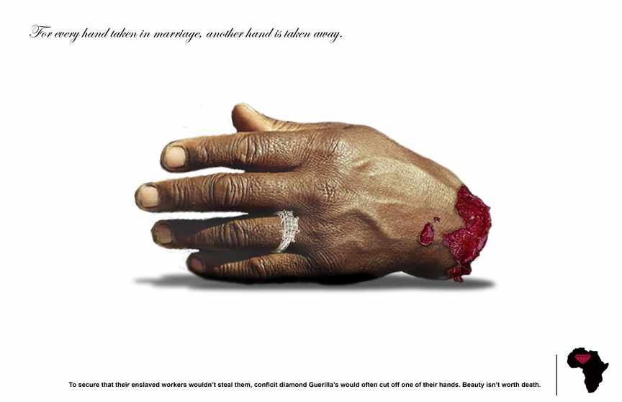
Conflict Diamonds

Slide 2
The Issue - Cultural Globalization
The major markets for Diamonds are in Western developed nations.
Associated with love, engagement and marriage
Cultural tradition to give a diamond ring to propose.

Slide 3
Diamond Ads
https://www.youtube.com/watch?v=8pU6WQXkiOU
https://www.youtube.com/watch?v=plg7Uw9NeDY

Slide 4
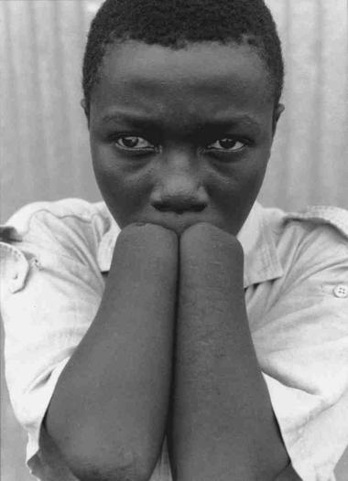
The Issue - Conflict
Diamonds fuel wars in many countries
They are used as currency to buy weapons to support war mostly in African countries.
Sierra Leone and Liberia civil wars fueled by conflict diamonds used to buy small arms.
Once an army takes over an area they enslave the locals to work in mines.
Hands are cut off for refusal to work as slaves and to control populations once a village is taken over.

Slide 5
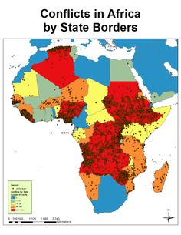
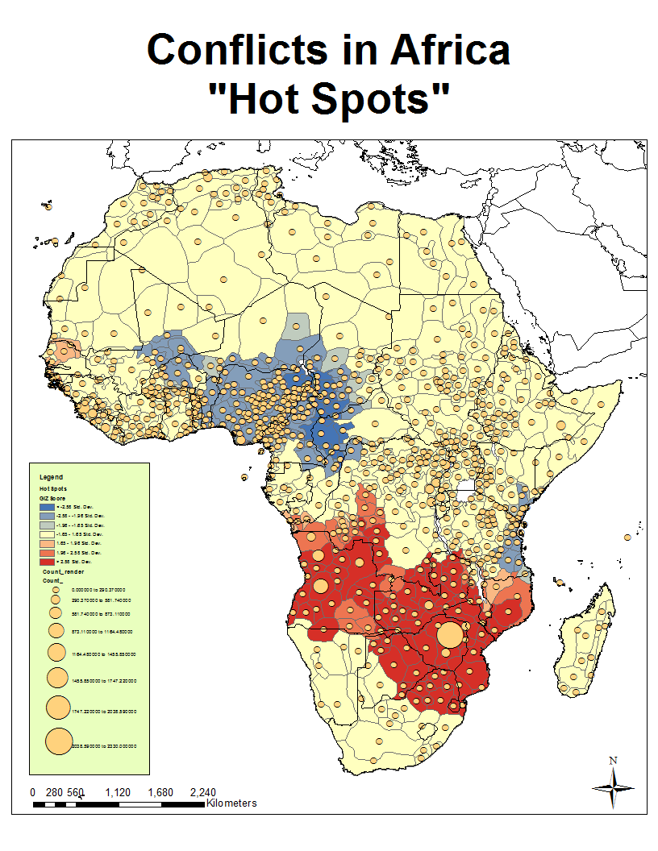
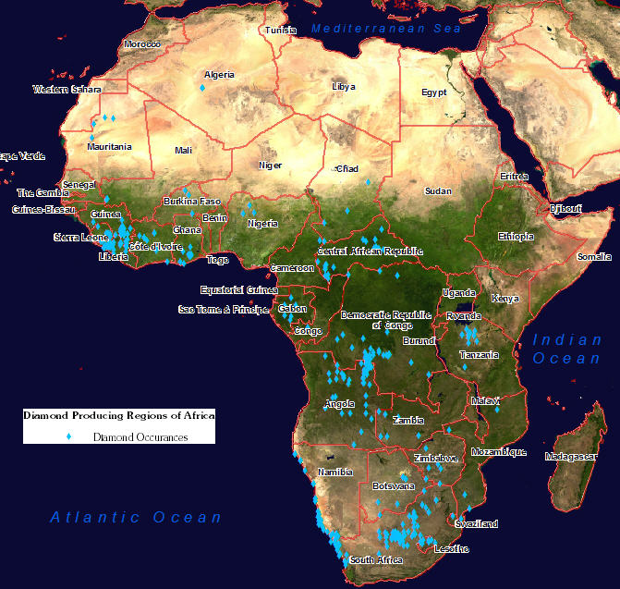
Diamonds in Africa

Slide 6
The Issue - Child Soldiers
Many of the armies in Africa use child soldiers.
They are kidnaped and are dependant on generals for food, shelter etc.
They are trained and drugged before going into combat.
Children are used because they do not understand their consequences and will do things that rational adults would not.
Children are also used as slaves to mine diamonds.

Slide 7
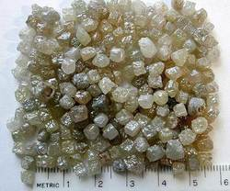
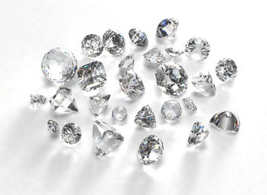
The issue - Diamond Polishers
Diamonds are dull when first mined
These are called Rough diamonds
India has the largest diamond polishing industry in the world.
Located in Sarat, India

Slide 8
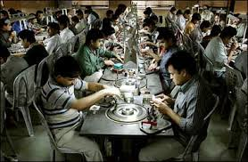
The Issue - Diamond Polishing
Diamonds are polished using sweatshop labour
Workers experience ill health effects from breathing in the polished diamond particles.
For and hour worth of polishing, companies pay the workers $1 and profit $1000 once sold.

Slide 9
Kimberley Process
The Kimberley process is an agreement between 76 diamond companies to ensure they are not buying conflict diamond.
Companies now certify where a diamond is from.
Does not deal with the polishing industry.
No Legal responsibility.

